Slide 1
Dynamic Programming
Dynamic programming is another strategy for designing algorithms
Use when problem breaks down into recurring small subproblems

Slide 2
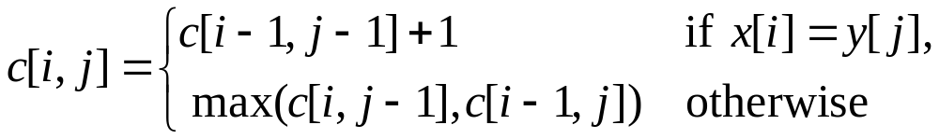
Optimal Substructure of LCS
Observation 1: Optimal substructure
  A simple recursive algorithm will suffice
Observation 2: Overlapping subproblems
  Find some places where we solve the same subproblem more than once

Slide 3
Structure of Subproblems
For the LCS problem:
  There are few subproblems in total
  And many recurring instances of each
    (unlike divide & conquer, where subproblems unique)
How many distinct problems exist for the LCS of x[1..m] and y[1..n]?
A: mn

Slide 4
Memoization
Memoization is another way to deal with overlapping subproblems
  After computing the solution to a subproblem, store in a table
  Subsequent calls just do a table lookup
Can modify recursive alg to use memoziation:
  There are mn subproblems
  How many times is each subproblem wanted?
  What will be the running time for this algorithm? The running space?

Slide 5
Dynamic Programming
Dynamic programming: build table bottom-up
  Same table as memoization, but instead of starting at (m,n) and recursing down, start at (1,1)
Least Common Subsequence: LCS easy to calculate from LCS of prefixes
    As your homework shows, can actually reduce space to O(min(m,n))

Slide 6
Dynamic Programming
Summary of the basic idea:
  Optimal substructure: optimal solution to problem consists of optimal solutions to subproblems
  Overlapping subproblems: few subproblems in total, many recurring instances of each
  Solve bottom-up, building a table of solved subproblems that are used to solve larger ones
Variations:
  “Table” could be 3-dimensional, triangular, a tree, etc.

Slide 7
Greedy Algorithms

Slide 8
Overview
Like dynamic programming, used to solve optimization problems.
Dynamic programming can be overkill; greedy algorithms tend to be easier to code
Problems exhibit optimal substructure (like DP).
Problems also exhibit the greedy-choice property.
  When we have a choice to make, make the one that looks best right now.
  Make a locally optimal choice in hope of getting a globally optimal solution.

Slide 9
Greedy Strategy
The choice that seems best at the moment is the one we go with.
  Prove that when there is a choice to make, one of the optimal choices is the greedy choice. Therefore, it’s always safe to make the greedy choice.
  Show that all but one of the subproblems resulting from the greedy choice are empty.

Slide 10
Activity-Selection Problem
Problem: get your money’s worth out of a festival
  Buy a wristband that lets you onto any ride
  Lots of rides, each starting and ending at different times
  Your goal: ride as many rides as possible
    Another, alternative goal that we don’t solve here: maximize time spent on rides
Welcome to the activity selection problem

Slide 11
Activity-selection Problem
Input: Set S of n activities, a₁, a₂, …, a_{n}.
  s_{i} = start time of activity i.
  f_{i} = finish time of activity i.
Output: Subset A of maximum number of compatible activities.
  Two activities are compatible, if their intervals don’t overlap.
Example:
Activities in each line
are compatible.
2
5
3
6
1
4
7

Slide 12
Optimal Substructure
Assume activities are sorted by finishing times.
  f₁ ≤ f₂ ≤ … ≤ f_{n}.
Suppose an optimal solution includes activity a_{k}.
  This generates two subproblems.
  Selecting from a₁, …, a_{k-1}, activities compatible with one another, and that finish before a_{k} starts (compatible with a_{k}).
  Selecting from a_{k+1}, …, a_{n}, activities compatible with one another, and that start after a_{k} finishes.
  The solutions to the two subproblems must be optimal.
    Prove using the cut-and-paste approach.

Slide 13
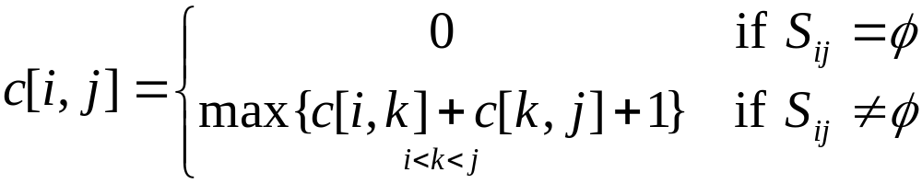
Recursive Solution
Let S_{ij} = subset of activities in S that start after a_{i} finishes and finish before a_{j} starts.
Subproblems: Selecting maximum number of mutually compatible activities from S_{ij}.
Let c[i, j] = size of maximum-size subset of mutually compatible activities in S_{ij}.
Recursive
Solution:

Slide 14
Activity Selection:
Repeated Subproblems
Consider a recursive algorithm that tries all possible compatible subsets to find a maximal set, and notice repeated subproblems:
S
1∈A?
yes
no
S’
2∈A?
S-{1}
2∈A?
yes
no
yes
no
S’’
S’-{2}
S’’
S-{1,2}

Slide 15
Greedy Choice Property
Dynamic programming? Memoize? Yes, but…
Activity selection problem also exhibits the greedy choice property:
  Locally optimal choice ⇒ globally optimal sol’n
  Them 16.1: if S is an activity selection problem sorted by finish time, then ∃ optimal solution
  A ⊆ S such that {1} ∈ A
    Sketch of proof: if ∃ optimal solution B that does not contain {1}, can always replace first activity in B with {1} (Why?). Same number of activities, thus optimal.

Slide 16
Greedy-choice Property
The problem also exhibits the greedy-choice property.
  There is an optimal solution to the subproblem S_{ij}, that includes the activity with the smallest finish time in set S_{ij}.
  Can be proved easily.
Hence, there is an optimal solution to S that includes a₁.
Therefore, make this greedy choice without solving subproblems first and evaluating them.
Solve the subproblem that ensues as a result of making this greedy choice.
Combine the greedy choice and the solution to the subproblem.

Slide 17
Recursive Algorithm
Recursive-Activity-Selector (s, f, i, j)
m ← i+1
while m < j and s_{m} < f_{i}
do m ← m+1
if m < j
then return {a_{m}} ∪
Recursive-Activity-Selector(s, f, m, j)
else return φ
Initial Call: Recursive-Activity-Selector (s, f, 0, n+1)
Complexity: Θ(n)
Straightforward to convert the algorithm to an iterative one.

Slide 18
Typical Steps
Cast the optimization problem as one in which we make a choice and are left with one subproblem to solve.
Prove that there’s always an optimal solution that makes the greedy choice, so that the greedy choice is always safe.
Show that greedy choice and optimal solution to subproblem ⇒ optimal solution to the problem.
Make the greedy choice and solve top-down.
May have to preprocess input to put it into greedy order.
  Example: Sorting activities by finish time.

Slide 19
Activity Selection:
A Greedy Algorithm
So actual algorithm is simple:
  Sort the activities by finish time
  Schedule the first activity
  Then schedule the next activity in sorted list which starts after previous activity finishes
  Repeat until no more activities
Intuition is even more simple:
  Always pick the shortest ride available at the time

Slide 20
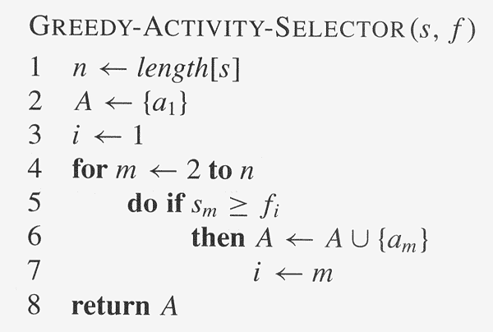
Copyright © The McGraw-Hill Companies, Inc. Permission required for reproduction or display.

Slide 21
Elements of Greedy Algorithms
Greedy-choice Property.
  A globally optimal solution can be arrived at by making a locally optimal (greedy) choice.
Optimal Substructure.

Slide 22
Knapsack Problem

Slide 23
The Knapsack Problem
The famous knapsack problem:
  A thief breaks into a museum. Fabulous paintings, sculptures, and jewels are everywhere. The thief has a good eye for the value of these objects, and knows that each will fetch hundreds or thousands of dollars on the clandestine art collector’s market. But, the thief has only brought a single knapsack to the scene of the robbery, and can take away only what he can carry. What items should the thief take to maximize the haul?

Slide 24
0-1 Knapsack problem
Given a knapsack with maximum capacity W, and a set S consisting of n items
Each item i has some weight w_{i} and benefit value b_{i} (all w_{i} , b_{i} and W are integer values)
Problem: How to pack the knapsack to achieve maximum total value of packed items?

Slide 25
0-1 Knapsack problem: a picture
Weight
Benefit value
w_{i}
b_{i}
Items
3
2
This is a knapsack
Max weight: W = 20
3
4
4
5
5
8
W = 20
9
10

Slide 26
The Knapsack Problem
More formally, the 0-1 knapsack problem:
  The thief must choose among n items, where the ith item worth v_{i} dollars and weighs w_{i} pounds
  Carrying at most W pounds, maximize value
    Note: assume v_{i}, w_{i}, and W are all integers
    “0-1” b/c each item must be taken or left in entirety
A variation, the fractional knapsack problem:
  Thief can take fractions of items
  Think of items in 0-1 problem as gold ingots, in fractional problem as buckets of gold dust

Slide 27
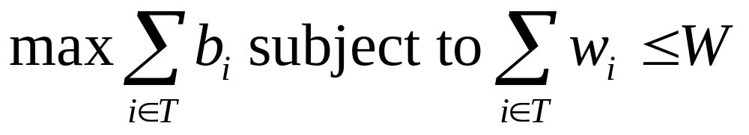
0-1 Knapsack problem
Problem, in other words, is to find
The problem is called a “0-1” problem, because each item must be entirely accepted or rejected.
Just another version of this problem is the “Fractional Knapsack Problem”, where we can take fractions of items.

Slide 28
0-1 Knapsack problem: brute-force approach
Let’s first solve this problem with a straightforward algorithm
Since there are n items, there are 2^{n} possible combinations of items.
We go through all combinations and find the one with the most total value and with total weight less or equal to W
Running time will be O(2^{n})

Slide 29
0-1 Knapsack problem: brute-force approach
Can we do better?
Yes, with an algorithm based on dynamic programming
We need to carefully identify the subproblems
Let’s try this:
If items are labeled 1..n, then a subproblem
would be to find an optimal solution for
S_{k} = {items labeled 1, 2, .. k}

Slide 30
Defining a Subproblem
If items are labeled 1..n, then a subproblem would be to find an optimal solution for S_{k} = {items labeled 1, 2, .. k}
This is a valid subproblem definition.
The question is: can we describe the final solution (S_{n} ) in terms of subproblems (S_{k})?
Unfortunately, we can’t do that. Explanation follows….

Slide 31
Defining a Subproblem
w₁ =2
b₁ =3
w₂ =4
b₂ =5
w₃ =5
b₃ =8
w₄ =3
b₄ =4
Weight
Benefit
Item
#
w_{i}
b_{i}
?
1
2
3
Max weight: W = 20
For S₄:
Total weight: 14;
total benefit: 20
S₄
2
3
4
S₅
3
4
5
4
5
8
5
9
10
w₁ =2
b₁ =3
w₂ =4
b₂ =5
w₃ =5
b₃ =8
w₄ =9
b₄ =10
Solution for S₄ is not part of the solution for S₅!!!
For S₅:
Total weight: 20
total benefit: 26

Slide 32
Defining a Subproblem (continued)
As we have seen, the solution for S₄ is not part of the solution for S₅
So our definition of a subproblem is flawed and we need another one!
Let’s add another parameter: w, which will represent the exact weight for each subset of items
The subproblem then will be to compute B[k,w]

Slide 33
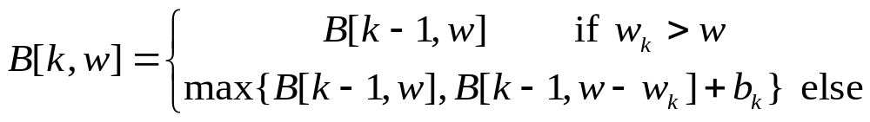
Recursive Formula for subproblems
Recursive formula for subproblems:
It means, that the best subset of S_{k} that has total weight w is one of the two:
1) the best subset of S_{k-1} that has total weight w, or
2) the best subset of S_{k-1} that has total weight w-w_{k} plus the item k

Slide 34
Recursive Formula
The best subset of S_{k} that has the total weight w, either contains item k or not.
First case: w_{k}>w. Item k can’t be part of the solution, since if it was, the total weight would be > w, which is unacceptable
Second case: w_{k} <=w. Then the item k can be in the solution, and we choose the case with greater value

Slide 35
The Knapsack Problem
And Optimal Substructure
Both variations exhibit optimal substructure
To show this for the 0-1 problem, consider the most valuable load weighing at most W pounds
  If we remove item j from the load, what do we know about the remaining load?
  A: remainder must be the most valuable load weighing at most W - w_{j} that thief could take from museum, excluding item j

Slide 36
Solving The Knapsack Problem
The optimal solution to the fractional knapsack problem can be found with a greedy algorithm
  How?
The optimal solution to the 0-1 problem cannot be found with the same greedy strategy
  Greedy strategy: take in order of dollars/pound
  Example: 3 items weighing 10, 20, and 30 pounds, knapsack can hold 50 pounds
    Suppose item 2 is worth $100. Assign values to the other items so that the greedy strategy will fail

Slide 37
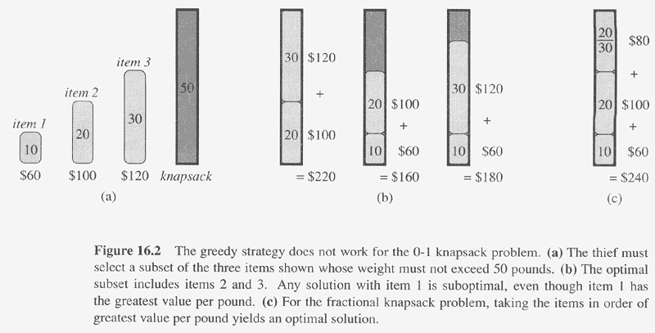
Copyright © The McGraw-Hill Companies, Inc. Permission required for reproduction or display.

Slide 38
The Knapsack Problem:
Greedy Vs. Dynamic
The fractional problem can be solved greedily
The 0-1 problem cannot be solved with a greedy approach
  As you have seen, however, it can be solved with dynamic programming

Slide 39
0-1 Knapsack Algorithm
for w = 0 to W
B[0,w] = 0
for i = 0 to n
B[i,0] = 0
for w = 0 to W
if w_{i} <= w // item i can be part of the solution
if b_{i} + B[i-1,w-w_{i}] > B[i-1,w]
B[i,w] = b_{i} + B[i-1,w- w_{i}]
else
B[i,w] = B[i-1,w]
else B[i,w] = B[i-1,w] // w_{i} > w

Slide 40
Running time
for w = 0 to W
B[0,w] = 0
for i = 0 to n
B[i,0] = 0
for w = 0 to W
< the rest of the code >
O(W)
Repeat n times
O(W)
What is the running time of this algorithm?
O(n*W)
Remember that the brute-force algorithm
takes O(2^{n})

Slide 41
Example
Let’s run our algorithm on the
following data:
n = 4 (# of elements)
W = 5 (max weight)
Elements (weight, benefit):
(2,3), (3,4), (4,5), (5,6)

Slide 42
Example (2)
i
0
1
2
3
4
W
0
0
1
0
2
0
3
0
4
0
5
0
for w = 0 to W
B[0,w] = 0

Slide 43
Example (3)
i
0
1
2
3
4
W
0
0
0
0
0
0
1
0
2
0
3
0
4
0
5
0
for i = 0 to n
B[i,0] = 0

Slide 44
Example (4)
Items:
1: (2,3)
2: (3,4)
3: (4,5)
4: (5,6)
i
0
1
2
3
4
W
0
0
0
0
0
0
i=1
b_{i}=3
w_{i}=2
w=1
w-w_{i} =-1
1
0
0
2
0
3
0
4
0
5
0
if w_{i} <= w // item i can be part of the solution
if b_{i} + B[i-1,w-w_{i}] > B[i-1,w]
B[i,w] = b_{i} + B[i-1,w- w_{i}]
else
B[i,w] = B[i-1,w]
else B[i,w] = B[i-1,w] // w_{i} > w

Slide 45
Example (5)
Items:
1: (2,3)
2: (3,4)
3: (4,5)
4: (5,6)
i
0
1
2
3
4
W
0
0
0
0
0
0
i=1
b_{i}=3
w_{i}=2
w=2
w-w_{i} =0
1
0
0
2
0
3
3
0
4
0
5
0
if w_{i} <= w // item i can be part of the solution
if b_{i} + B[i-1,w-w_{i}] > B[i-1,w]
B[i,w] = b_{i} + B[i-1,w- w_{i}]
else
B[i,w] = B[i-1,w]
else B[i,w] = B[i-1,w] // w_{i} > w

Slide 46
Example (6)
Items:
1: (2,3)
2: (3,4)
3: (4,5)
4: (5,6)
i
0
1
2
3
4
W
0
0
0
0
0
0
i=1
b_{i}=3
w_{i}=2
w=3
w-w_{i}=1
1
0
0
2
0
3
3
0
3
4
0
5
0
if w_{i} <= w // item i can be part of the solution
if b_{i} + B[i-1,w-w_{i}] > B[i-1,w]
B[i,w] = b_{i} + B[i-1,w- w_{i}]
else
B[i,w] = B[i-1,w]
else B[i,w] = B[i-1,w] // w_{i} > w

Slide 47
Example (7)
Items:
1: (2,3)
2: (3,4)
3: (4,5)
4: (5,6)
i
0
1
2
3
4
W
0
0
0
0
0
0
i=1
b_{i}=3
w_{i}=2
w=4
w-w_{i}=2
1
0
0
2
0
3
3
0
3
4
0
3
5
0
if w_{i} <= w // item i can be part of the solution
if b_{i} + B[i-1,w-w_{i}] > B[i-1,w]
B[i,w] = b_{i} + B[i-1,w- w_{i}]
else
B[i,w] = B[i-1,w]
else B[i,w] = B[i-1,w] // w_{i} > w

Slide 48
Example (8)
Items:
1: (2,3)
2: (3,4)
3: (4,5)
4: (5,6)
i
0
1
2
3
4
W
0
0
0
0
0
0
i=1
b_{i}=3
w_{i}=2
w=5
w-w_{i}=2
1
0
0
2
0
3
3
0
3
4
0
3
5
0
3
if w_{i} <= w // item i can be part of the solution
if b_{i} + B[i-1,w-w_{i}] > B[i-1,w]
B[i,w] = b_{i} + B[i-1,w- w_{i}]
else
B[i,w] = B[i-1,w]
else B[i,w] = B[i-1,w] // w_{i} > w

Slide 49
Example (9)
Items:
1: (2,3)
2: (3,4)
3: (4,5)
4: (5,6)
i
0
1
2
3
4
W
0
0
0
0
0
0
i=2
b_{i}=4
w_{i}=3
w=1
w-w_{i}=-2
1
0
0
0
2
0
3
3
0
3
4
0
3
5
0
3
if w_{i} <= w // item i can be part of the solution
if b_{i} + B[i-1,w-w_{i}] > B[i-1,w]
B[i,w] = b_{i} + B[i-1,w- w_{i}]
else
B[i,w] = B[i-1,w]
else B[i,w] = B[i-1,w] // w_{i} > w

Slide 50
Example (10)
Items:
1: (2,3)
2: (3,4)
3: (4,5)
4: (5,6)
i
0
1
2
3
4
W
0
0
0
0
0
0
i=2
b_{i}=4
w_{i}=3
w=2
w-w_{i}=-1
1
0
0
0
2
0
3
3
3
0
3
4
0
3
5
0
3
if w_{i} <= w // item i can be part of the solution
if b_{i} + B[i-1,w-w_{i}] > B[i-1,w]
B[i,w] = b_{i} + B[i-1,w- w_{i}]
else
B[i,w] = B[i-1,w]
else B[i,w] = B[i-1,w] // w_{i} > w

Slide 51
Example (11)
Items:
1: (2,3)
2: (3,4)
3: (4,5)
4: (5,6)
i
0
1
2
3
4
W
0
0
0
0
0
0
i=2
b_{i}=4
w_{i}=3
w=3
w-w_{i}=0
1
0
0
0
2
0
3
3
3
0
3
4
4
0
3
5
0
3
if w_{i} <= w // item i can be part of the solution
if b_{i} + B[i-1,w-w_{i}] > B[i-1,w]
B[i,w] = b_{i} + B[i-1,w- w_{i}]
else
B[i,w] = B[i-1,w]
else B[i,w] = B[i-1,w] // w_{i} > w

Slide 52
Example (12)
Items:
1: (2,3)
2: (3,4)
3: (4,5)
4: (5,6)
i
0
1
2
3
4
W
0
0
0
0
0
0
i=2
b_{i}=4
w_{i}=3
w=4
w-w_{i}=1
1
0
0
0
2
0
3
3
3
0
3
4
4
0
3
4
5
0
3
if w_{i} <= w // item i can be part of the solution
if b_{i} + B[i-1,w-w_{i}] > B[i-1,w]
B[i,w] = b_{i} + B[i-1,w- w_{i}]
else
B[i,w] = B[i-1,w]
else B[i,w] = B[i-1,w] // w_{i} > w

Slide 53
Example (13)
Items:
1: (2,3)
2: (3,4)
3: (4,5)
4: (5,6)
i
0
1
2
3
4
W
0
0
0
0
0
0
i=2
b_{i}=4
w_{i}=3
w=5
w-w_{i}=2
1
0
0
0
2
0
3
3
3
0
3
4
4
0
3
4
5
0
3
7
if w_{i} <= w // item i can be part of the solution
if b_{i} + B[i-1,w-w_{i}] > B[i-1,w]
B[i,w] = b_{i} + B[i-1,w- w_{i}]
else
B[i,w] = B[i-1,w]
else B[i,w] = B[i-1,w] // w_{i} > w

Slide 54
Example (14)
Items:
1: (2,3)
2: (3,4)
3: (4,5)
4: (5,6)
i
0
1
2
3
4
W
0
0
0
0
0
0
i=3
b_{i}=5
w_{i}=4
w=1..3
1
0
0
0
0
0
2
0
3
3
3
3
0
3
4
4
4
0
3
4
5
0
3
7
if w_{i} <= w // item i can be part of the solution
if b_{i} + B[i-1,w-w_{i}] > B[i-1,w]
B[i,w] = b_{i} + B[i-1,w- w_{i}]
else
B[i,w] = B[i-1,w]
else B[i,w] = B[i-1,w] // w_{i} > w

Slide 55
Example (15)
Items:
1: (2,3)
2: (3,4)
3: (4,5)
4: (5,6)
i
0
1
2
3
4
W
0
0
0
0
0
0
i=3
b_{i}=5
w_{i}=4
w=4
w- w_{i}=0
1
0
0
0
0
0
2
0
3
3
3
3
0
3
4
4
4
0
3
4
5
5
0
3
7
if w_{i} <= w // item i can be part of the solution
if b_{i} + B[i-1,w-w_{i}] > B[i-1,w]
B[i,w] = b_{i} + B[i-1,w- w_{i}]
else
B[i,w] = B[i-1,w]
else B[i,w] = B[i-1,w] // w_{i} > w

Slide 56
Example (15)
Items:
1: (2,3)
2: (3,4)
3: (4,5)
4: (5,6)
i
0
1
2
3
4
W
0
0
0
0
0
0
i=3
b_{i}=5
w_{i}=4
w=5
w- w_{i}=1
1
0
0
0
0
0
2
0
3
3
3
3
0
3
4
4
4
0
3
4
5
5
0
3
7
7
if w_{i} <= w // item i can be part of the solution
if b_{i} + B[i-1,w-w_{i}] > B[i-1,w]
B[i,w] = b_{i} + B[i-1,w- w_{i}]
else
B[i,w] = B[i-1,w]
else B[i,w] = B[i-1,w] // w_{i} > w

Slide 57
Example (16)
Items:
1: (2,3)
2: (3,4)
3: (4,5)
4: (5,6)
i
0
1
2
3
4
W
0
0
0
0
0
0
i=3
b_{i}=5
w_{i}=4
w=1..4
1
0
0
0
0
0
0
2
0
3
3
3
3
3
0
3
4
4
4
4
0
3
4
5
5
5
0
3
7
7
if w_{i} <= w // item i can be part of the solution
if b_{i} + B[i-1,w-w_{i}] > B[i-1,w]
B[i,w] = b_{i} + B[i-1,w- w_{i}]
else
B[i,w] = B[i-1,w]
else B[i,w] = B[i-1,w] // w_{i} > w

Slide 58
Example (17)
Items:
1: (2,3)
2: (3,4)
3: (4,5)
4: (5,6)
i
0
1
2
3
4
W
0
0
0
0
0
0
i=3
b_{i}=5
w_{i}=4
w=5
1
0
0
0
0
0
0
2
0
3
3
3
3
3
0
3
4
4
4
4
0
3
4
5
5
5
0
3
7
7
7
if w_{i} <= w // item i can be part of the solution
if b_{i} + B[i-1,w-w_{i}] > B[i-1,w]
B[i,w] = b_{i} + B[i-1,w- w_{i}]
else
B[i,w] = B[i-1,w]
else B[i,w] = B[i-1,w] // w_{i} > w

Slide 59
Comments
This algorithm only finds the max possible value that can be carried in the knapsack
To know the items that make this maximum value, an addition to this algorithm is necessary
Please see LCS algorithm from the previous lecture for the example how to extract this data from the table we built

Slide 60
Dynamic Programming
Dynamic programming is a useful technique of solving certain kind of problems
When the solution can be recursively described in terms of partial solutions, we can store these partial solutions and re-use them as necessary
Running time (Dynamic Programming algorithm vs. naïve algorithm):
  LCS: O(m*n) vs. O(n * 2^{m})
  0-1 Knapsack problem: O(W*n) vs. O(2^{n})

